Slide 1

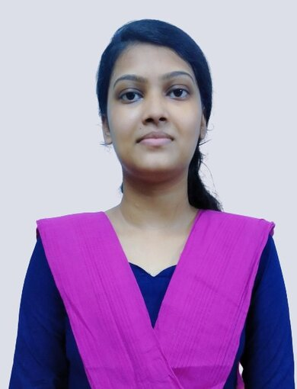

Face recognition in unconstrained environment using Deep Learning
Project ID: 22301
By
Swapnadeep Samal Roll No: CSE-201810384
Anisha Mohanta Roll No: CSE-201843391
Under the guidance of
Prof. Pradeep Kumar Jena
Notes:
B-TECH PROJECT MID-SEM PRESENTATION 2011
BY KHUSHBU KHAN & ISAN SAHOO

Slide 2
OUTLINE
PROBLEM STATEMENT
OBJECTIVE
PROJECT SPECIFICATION
METHODOLOGY
POSSIBLE OUTCOME
REFERENCES
201810384 Swapnadeep Samal
201843391 Anisha Mohanta
Notes:
B-TECH PROJECT MID-SEM PRESENTATION 2011
BY KHUSHBU KHAN & ISAN SAHOO
2

Slide 3
PROBLEM STATEMENT
Developing a highly efficient face recognition framework to learn a robust face detection in an unconstrained environment using aggressive data augmentation and CNN.
To learn face representation from large-scale data with massive noisy and occluded face.
201810384 Swapnadeep Samal
201843391 Anisha Mohanta
Notes:
B-TECH PROJECT MID-SEM PRESENTATION 2011
BY KHUSHBU KHAN & ISAN SAHOO
3

Slide 4
OBJECTIVE
To design an effective face recognition system that has an ability to recognize the faces in real-time.
This effective system will also be able to identify the faces even when there is a massive noise present within the image.
201810384 Swapnadeep Samal
201843391 Anisha Mohanta
Notes:
B-TECH PROJECT MID-SEM PRESENTATION 2011
BY KHUSHBU KHAN & ISAN SAHOO
4

Slide 5
PROJECT SPECIFICATION
Tools and Technology to be used in this project
Programming Language : Python
Computer Vision Library : OpenCV
OpenCV – Python utilizes Numpy.
Numpy is an highly optimized library for numerical operations.
All the OpenCV array structures are converted to and from Numpy arrays.
201810384 Swapnadeep Samal
201843391 Anisha Mohanta
Notes:
B-TECH PROJECT MID-SEM PRESENTATION 2011
BY KHUSHBU KHAN & ISAN SAHOO
5

Slide 6
METHODOLOGY
Face Detection - Detect/identify faces in an image (using a face detection model) – for simplicity, this will only use images with one face per person in it, not more/less.
Face Alignment - Goal is to scale and crop face images in the same way using a set of reference points located at fixed locations in the image.
Face Representation - the pixel values are transformed into a compact and discriminative feature vector, also known as a template. All the faces of a same subject should map to the similar feature vectors.
Face Matching - A result is produced by comparing the two templates, this indicates the likelihood of the subjects.
201810384 Swapnadeep Samal
201843391 Anisha Mohanta
Notes:
B-TECH PROJECT MID-SEM PRESENTATION 2011
BY KHUSHBU KHAN & ISAN SAHOO
6

Slide 7
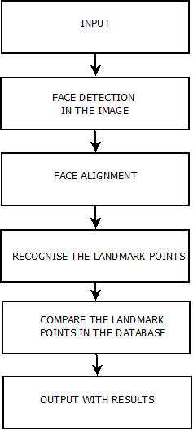
METHODOLOGY
Fig : Flowchart of the Face recognition in unconstrained environment using Deep Learning
201810384 Swapnadeep Samal
201843391 Anisha Mohanta
Notes:
B-TECH PROJECT MID-SEM PRESENTATION 2011
BY KHUSHBU KHAN & ISAN SAHOO
7

Slide 8
POSSIBLE OUTCOME
This project will show the detailed report about the face recognition and will identifies the subject.
This project will give an output with detailed information about the subject if the face is recognized.
For optimum performance we can use images of the people where the face is clearly visible and can train the CNN with more detailed images captured from different regions and scales to form a powerful face representation.
201810384 Swapnadeep Samal
201843391 Anisha Mohanta
Notes:
B-TECH PROJECT MID-SEM PRESENTATION 2011
BY KHUSHBU KHAN & ISAN SAHOO
8

Slide 9
REFERENCES
Cahit Gürel, Abdulkadir Erden Design of a Face Recognition System, Conference: The 15th International Conference on Machine Design and Production, UMTIK 2012
Rajeshwar Moghekar, Sachin Ahuja Soft Computing for Intelligent Systems pp 241-253| Cite As Face Recognition in Unconstrained Environment Using Deep Learning
Singh S, Prasad SVAV (2018) Techniques and challenges of face recognition: a critical review. Procedia Computer Sci 143:536–543.
Mostafa Mehdipour Ghazi, Hazim Kemal Ekenel; Proceedings of the IEEE Conference on Computer Vision and Pattern Recognition (CVPR) Workshops, 2016, pp. 34-41
201810384 Swapnadeep Samal
201843391 Anisha Mohanta

Slide 10
Thank You
201810384 Swapnadeep Samal
201843391 Anisha Mohanta

